Slide 1
Notes:
Let me start with a question that no doubt, all of us, as cognitive science enthusiasts have grappled with: how do we know that we are not living in a simulation. Well, 2019, A group of Physicists came to the conclusion that we don’t based on the fact that reality is simply too rich to simulate. The details of which I wont go into but this births an issue at the core of my research:

Slide 2
The Reality Gap
Notes:
The reality gap: the gap between simulation and real-life.

Slide 3
I think robots are cool
Notes:
Good morning everyone, I am Josheta srinivasan, a sophomore at Indiana University Bloomington intelligent systems engineering and cognitive science and I like robots. Which makes this issue hit closer to home, because while we may not necessarily spending a lot of time in simulations , our robot pals do. Simulations remain a crucial and prevelant way to train robot behaviours.

Slide 4
Notes:
But when you take these trained robots and put them in teh real-world, they don’t perform as well - because of this reality gap
From background research I found that a common approach to solve this issue was

Slide 5
Just add Noise!
Notes:
adding noise to the simulator; But a systematic study or prescription of how exactly one should go about doing so seemed less explored.

Slide 6
RESEARCH QUESTION
How does the
amount, location, and type of noise
added to the simulator affect the ability of robots to cross the
REALITY GAP ?
Notes:
So with the help of my research mentor: Prof. Eduardo Izquierdo and his research group, my research aims to study how the amount, location and type of noise added to a simulator that optimises the controller that controls this robot called the single legged walker affects its ability to cross the reality gap.

Slide 7
Research Hypothesis
No Noise
With Noise
Notes:
For the first pass of research; our preliminary hypothesis was simple enough - we expected walkers that were trained with noise to develop behaviours that aren’t going to be highly dependent on teh specific environment they are trained in and as such that hey would transfer batter into reality

Slide 8
Research Hypothesis
Less Robust
More Robust
Worse Transfer
Better Transfer
Notes:
. Secondarily we also looked at this measure called robustness - essentially just resistance to noise - ability of an agent to retain performance inspite of noise:.we hypothesised that more robust walkers would be better at crossing the gap.

Slide 9
Meet the Walker!
Notes:
It’s high time that we actually meet the robot: the single-legged walker.

Slide 10
BRAIN
BODY
ENV
Motor Map
Interaction map
Sensory map
Notes:
and essentially the whole system that we tried to simulate was made up of 3 subsystems: the brain - the body - and the environment ehich are all connected in such a way that a change in one affected a change in the other.

Slide 11
Continuous- Time Recurrent Neural Network (CTRNN)
BODY
ENV
Motor Map
Interaction map
Sensory map
Notes:
Brain: which in robotics would be consider the robot controller was implemented in our case using a recurrent time neural network. This was an important part of teh robot because this was what we put through the optimisation process.

Slide 12
Continuous- Time Recurrent Neural Network (CTRNN)
BODY
ENV
Motor Map
Interaction map
Sensory map
Notes:
Next, the body of the robot which was also simple

Slide 13
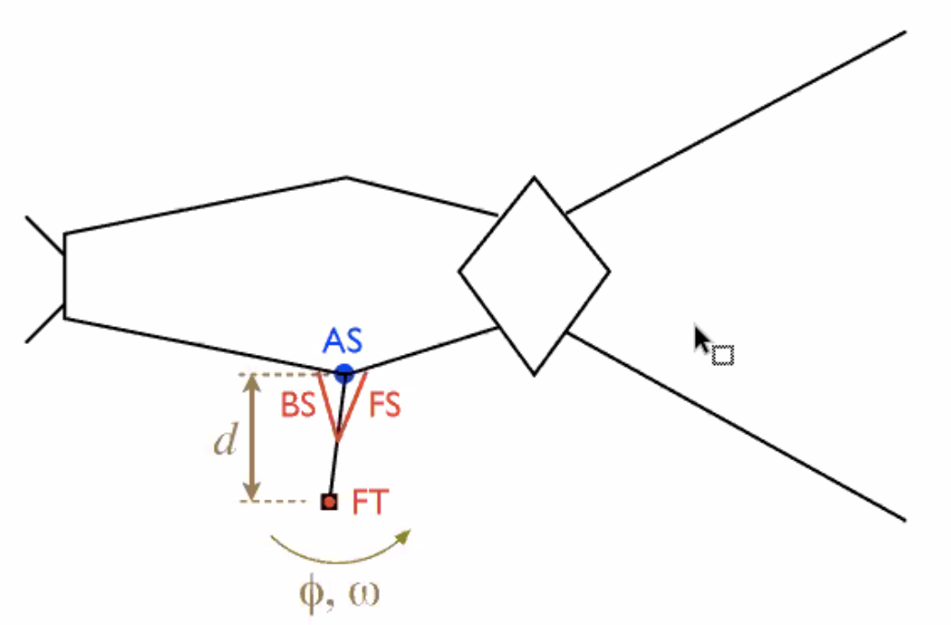
The Single-Legged Walker
One leg
Three Muscles/Effectors (Inputs)
FT: Foot Effector
BS: Backward Swing Effector
FS: Forward Swing Effector
One Sensor (Output)
AS: Angle Sensor
Notes:
And Basically consisted on 1 leg, of three muscles: foot, forward swing, backward, and 1 angle sensor (senses angle leg displaced). + how it move.

Slide 14
Continuous- Time Recurrent Neural Network (CTRNN)
1 leg;
3 Effectors;
1 Sensor
ENV
Motor Map
Interaction map
Sensory map
Notes:
Environment - everything around the robot,

Slide 15
Continuous- Time Recurrent Neural Network (CTRNN)
1 leg;
3 Effectors;
1 Sensor
Floor
Motor Map
Interaction map
Sensory map
Notes:
for the purposes of the simulation ; the main consideration was the floor that the robots contacting.

Slide 16
Research Methodology
CONDITIONS
No Noise
Noise to Neural Network parameters
Noise to Omega
Notes:
So our preliminary methodology consisted of three conditions:
1. Control: optimisation without any noise
2. Two noise conditions: where there was noise added to firstly the parameters of the neural network and secondly to this parameter omega which tracked the leg angular velocity.

Slide 17
Research Methodology
CONDITIONS
No Noise
Noise to Neural Network parameters
Noise to Omega
Optimizer
Evolutionary Algorithm
Notes:
So our first step was to optimise the these robots under these conditions: an Evolutionary Algorithm to do so :

Slide 18
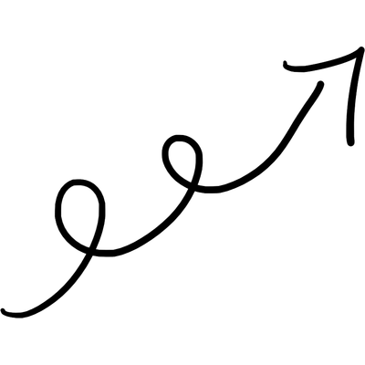
Evolutionary Algorithm
V/S
Notes:
Which, just to give you an intuitive undertsanidng, essentially just mimics biological evolution, where you have a randomly innitialzied population of things you want to evolve, put them in competition with each other and discard losers. So that ver time, this survival of the fittest-style phenomena result in our population being overall better performing and teh best performing member is taken to be the output of that specific optimisation.

Slide 19
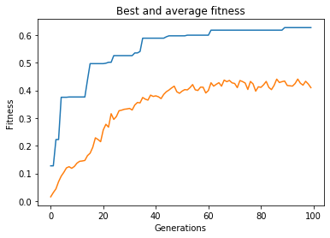
Evolutionary Algorithm
Best fitness
Average fitness
Notes:
Here’s a graph the illustrates this in action for iur walker and you can see how the fitness(which in our case was just the average velocity of the walker) increases with generation (how many times they were put in competition.

Slide 20
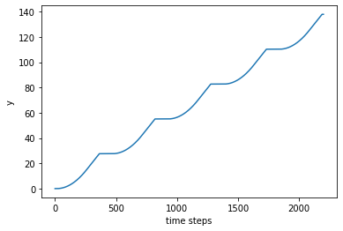
Evolutionary Algorithm
Distance-Time graph
Notes:
Distance time graph of a particular optimised solution the rhythmic walking dynamic that is observable; you can see lulls in motion where the robot is readjusting the leg and the increase in distance when it actually moves) (pretty neat walking pattern generated at the end of optimisation)

Slide 21
Research Methodology
CONDITIONS
No Noise
Noise to Neural Network parameters
Noise to Omega
Optimizer
Evolutionary Algorithm (10 trials x 3 conditions)
Notes:
And so our optimisation took 10 evolutionary runs for each condition:==> 30 controllers that we had evolved and took to the next step.

Slide 22
Research Methodology
CONDITIONS
No Noise
Noise to Neural Network parameters
Noise to Omega
Equalizer
Standardize; Accuracy
Optimizer
Evolutionary Algorithm (10 trials x 3 conditions)
Notes:
which was equalizing: gets a better performance value for each of the 30 robots under standardised and uniform environment.

Slide 23
Research Methodology
CONDITIONS
No Noise
Noise to Neural Network parameters
Noise to Omega
Equalizer
Standardize; Accuracy
Isolator
>0.58
Optimizer
Evolutionary Algorithm (10 trials x 3 conditions)
Notes:
Isolated: qualitatively dteremiend the ‘good’ performing solutions: which we determined to be determined by a fitness of above 0.58.

Slide 24
Research Methodology
CONDITIONS
No Noise
Noise to Neural Network parameters
Noise to Omega
Equalizer
Standardize; Accuracy
Isolator
>0.58
Robustness Test in SIMULATION
Noise to Leg Force
Optimizer
Evolutionary Algorithm (10 trials x 3 conditions)
Notes:
Then, we took all of these good solution through a very preliminary robustness test: which tested the walkers ability to retain its performance in an environment different to where it was trained: which in our was added noise to the Leg Force. Still in simulation tho; the purpose of which was to serve an indicator of which solutions we might expect to perform better in the real world. Important as I was still in the process of constructing my real-robot

Slide 25
Research Methodology
CONDITIONS
No Noise
Noise to Neural Network parameters
Noise to Omega
Equalizer
Standardize; Accuracy
Isolator
>0.58
Robustness Test in SIMULATION
Noise to Leg Force
Test in REAL LIFE
Optimizer
Evolutionary Algorithm (10 trials x 3 conditions)
Notes:
Which would be the next step: to test the evolved control mechanisms in the real-world with the real robot walker.

Slide 26
What did we Find?
Notes:
So, what did we find?

Slide 27
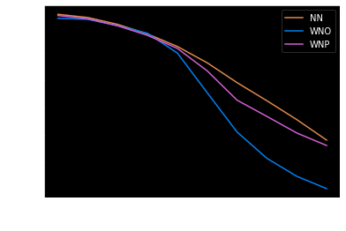
Preliminary Results
Notes:
What we found was pretty shocking, if you look at this graph, the x-axis was noise added the leg force and y axis is the fitness and you can tell the degradation of one’s fitness with more and more noise added, which was to be expected.
No-Noise condition has a flatter curve on this graph. (more gradual degradation -> higher robustness) compared to the Which was again, quite counter-intuitive, hence prompting me to take a deeper dive into the actual optimisation process and really look at what was going on.

Slide 28
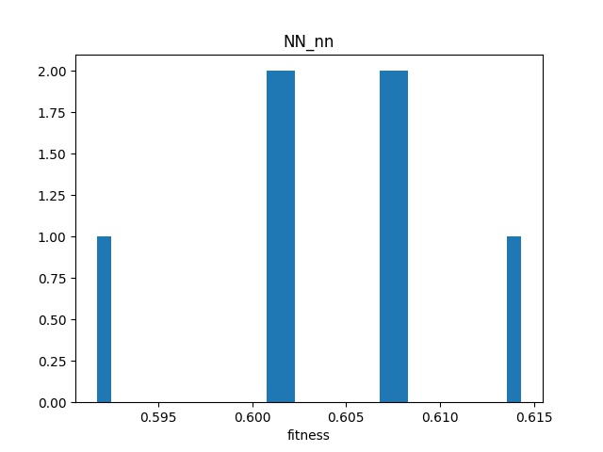
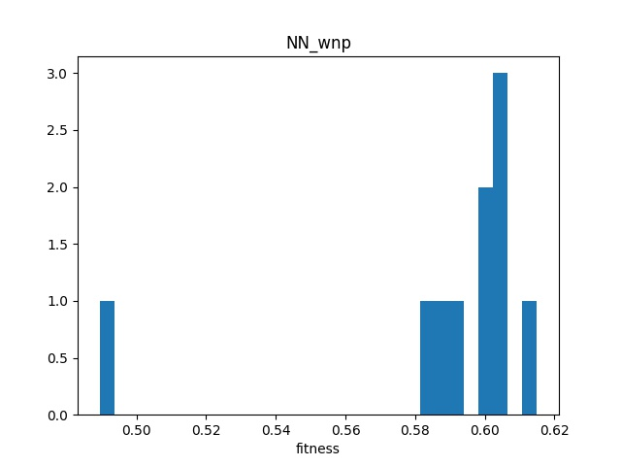
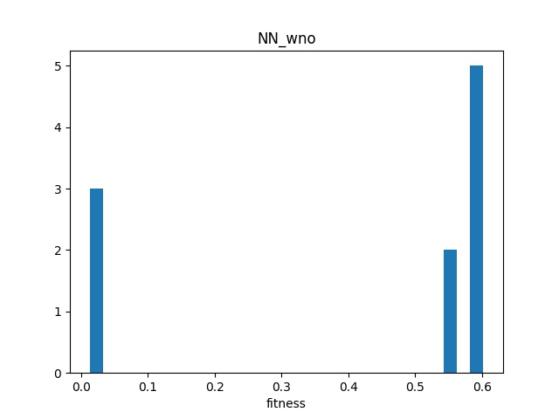
A Deeper Dive into Evolution
Condition | Isolated Solutions (solutions > 0.58 fitness)
No Noise | 10/10 trials
Noise to NN parameters | 9/10 trials
Noise to Omega | 5/10 trials
Notes:
And There were a few things that I noticed:
1. different conditions had different number of solutions evolve to be good: The NN condn had all 10 trials evolve to be good; the noise added to NN 9/10 and noise to omega had 5/10.

Slide 29
A Deeper Dive into Evolution
Notes:
In addition each condition also seems to have optimized differently. NN condn optimized pretty much as expected optimisation; average as you can see here in black is relatively represnetative and all trials converges to similar fitness value AND plateaus.

Slide 30
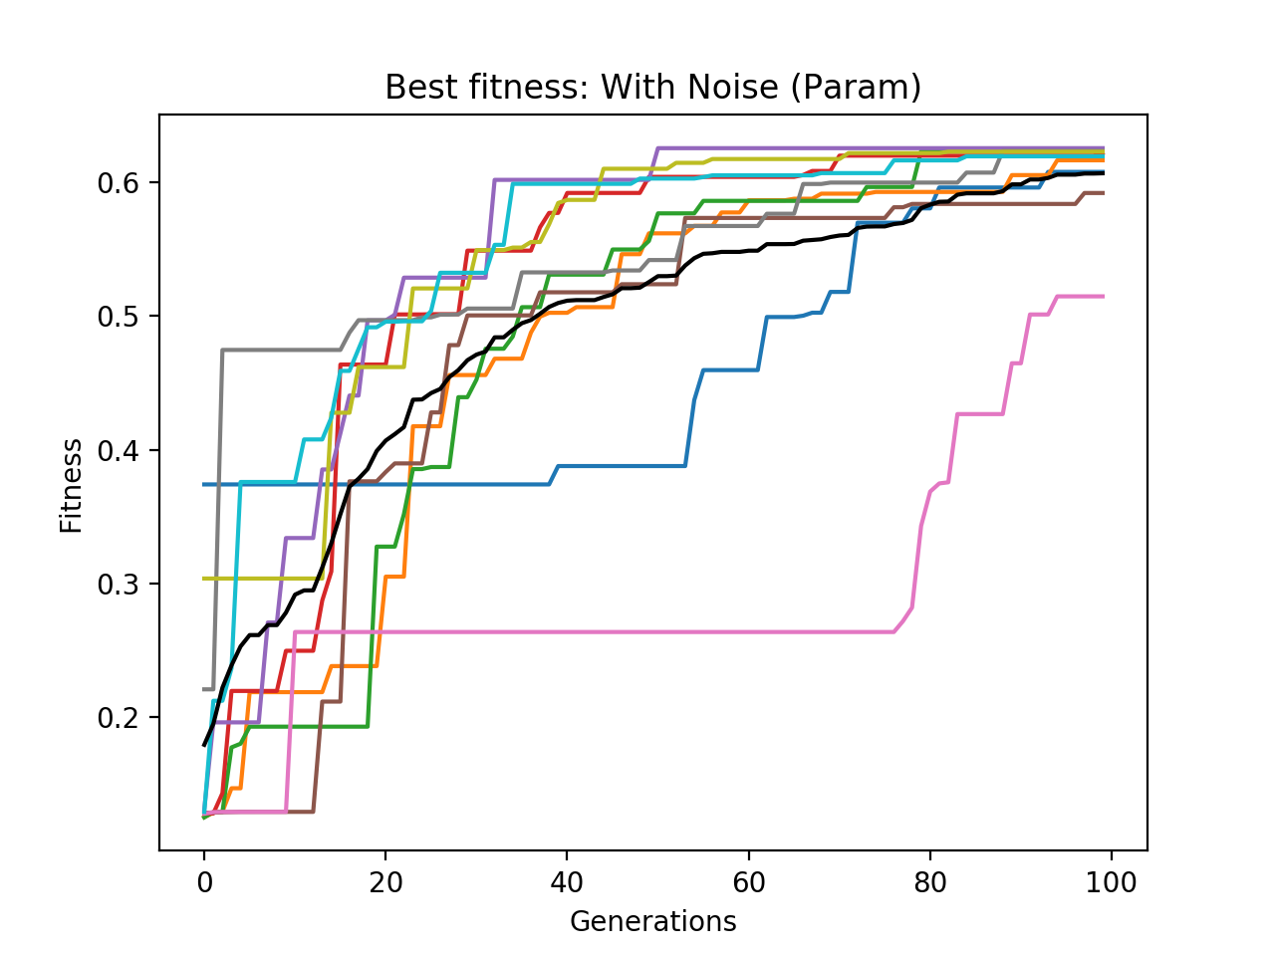
A Deeper Dive into Evolution
Notes:
However if you look at the noise NN param condn; this weired sort long early plateauing is visible noticeably and this was present in NO nois as well but definitely not as prominently.

Slide 31
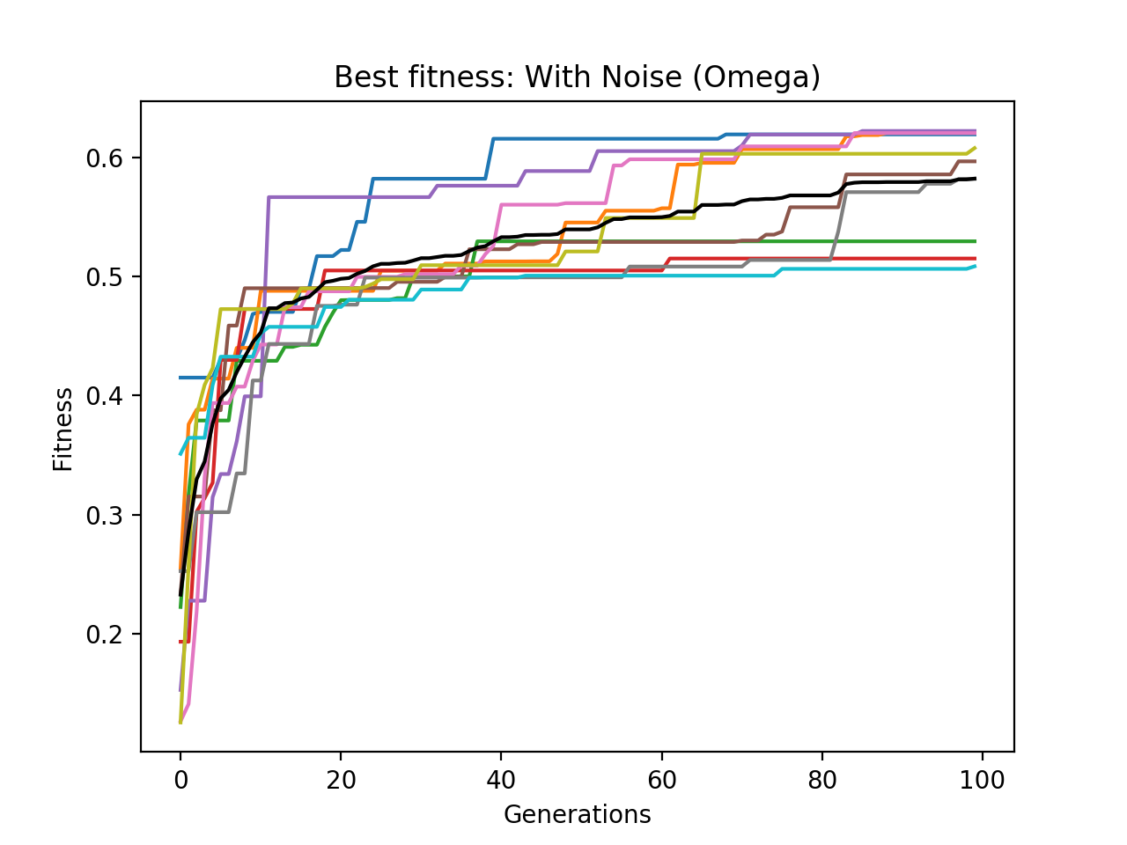
A Deeper Dive into Evolution
Notes:
But this is not at all noticeable in the omega codition which was almost the opposite in terms of having a very steep initial learning curve. However one does notivce A lot more variation in teh end point of evolution. ore specifically evolution seems to almost two-pronged where there are two clusters of convergence (0.5, 0.6)

Slide 32
A Deeper Dive into Evolution
Notes:
Both Noise conditions don’t show a full plateau.

Slide 33
A Deeper Dive into Evolution
Notes:
Lastly, if we take a step back we do notice a very distinct and different fitness distribution for each condn: (note about crude lines for illustrative purp) NN had a greater percent of walker at a higher fitness value. NN just had a much better evolution.

Slide 34
Immediate Takeaways
Uneven Fitness Distribution+ Noise condition non-plateau
➔ LONGER EVOLUTION
2. Varying evolutionary characteristics: early plateau // pronging
➔ MORE TRIALS
3. Trade-Off between performance optimization and generalization
No Noise
With Noise
Notes:
Some immediate takeaways: 1. Uneven fitness dist + non-plateau ==> which van be to an extent rectified with longer evolution time (250 instead of 100 gen)
2. Strange evolutionary characteristics such as early plateauing pronging. early plateauing behaviour need more trials for a conclusive determination of significant or outliying
3. The third takeaway, perhaps a more interesting one, there seems to exist a tradeoff between perf optimisation and gerenralization. This is what we see in NN conditions actually optimised to a greater fitness level compared to noise condos and what this translated to in the robustness test was that the NN were so good at doing what they were doing that they are resistant to perturbations and the noise conditions which ne would expect to be resistant because of the way they were trained, didn’t get to being as good at the behaviour —> behaviour itself is quite brittle, and just break down under the stress of noise.

Slide 35
So what?
Notes:
This does say something important about the significance of my study because even form this preliminary analysis we see that the location of noise addition quite profoundly affects not only robustness but even how these solutions actually optimise. Hence, understanding how the not only the location but type and amount of nose added affects optimisation, robustness and transferability is cruscial for the conscientious design of simulations and optimisations that ensure a good transference to real-life.

Slide 36
What Now?
Notes:
Few obvious next steps: 1st is to increase trial duration and trial numbers

Slide 37
What Now?
Notes:
Finish the construction of the real-life walker and test optimised controller in real-life which in addition to illuminating gap crossing abilities of the robots would also communicate whether robustness test is indeed a good indicator of transferability and allow me to test that hypothesis about robustness and transferability.

Slide 38
What Now?
Notes:
And lastly, once I have conclusions form that fine-tune and perfect the methodology after which we can permute the conditions to carry out teh systematic study we started out wth the pup of doing.

Slide 39
Thank You

Slide 40
Acknowledgement and References
I would like to thank: Eduardo J. Izquierdo for his mentorship; and Derek Whitley and Mathew Francisco for their guidance and resources for constructing the real robot.
[1] McDonald, Glenn. “We Are Not Living In A Simulation. Probably.” Fast Company, Fast Company, 14 Mar. 2018, www.fastcompa- ny.com/40537955/we-are-not-living-in-a-simulation-probably [2] “Math Insight.” The Idea of a Dynamical System - Math Insight, mathin- sight.org/dynamical_system_idea. [3] Beer, Randall D. “The Dynamics of Adaptive Behavior: A Research Program.” Robotics and Autono- mous Systems, vol. 20, no. 2-4, 1997, pp. 257–289., doi:10.1016/s0921-8890(96)00063-2. [4] Beer, Randall D., and John C. Gallagher. “Evolv- ing Dynamical Neural Networks for Adaptive Behavior.” Adaptive Behavior, vol. 1, no. 1, 1992, pp. 91–122., doi:10.1177/105971239200100105. [5] Lyttle, David N., et al. “Robustness, Flexibility, and Sensitivity in a Multifunctional Motor Control Model.” Biological Cybernetics, vol. 111, no. 1, 2016, pp. 25–47.,doi:10.1007/s00422-016-0704-8.

